Slide 1
Informatics Practices
Chapter 3 - Brief Overview of Python

Slide 2
Topics to be covered:-
3.1 Introduction to Python
3.2 Python Keywords
3.3 Identifiers
3.4 Variables
3.5 Data Types
3.6 Operators
3.7 Expressions
3.8 Input and Output 42
3.9 Debugging
3.10 Functions
3.11 if..else Statements
3.12 for Loop
3.13 Nested Loops

Slide 3
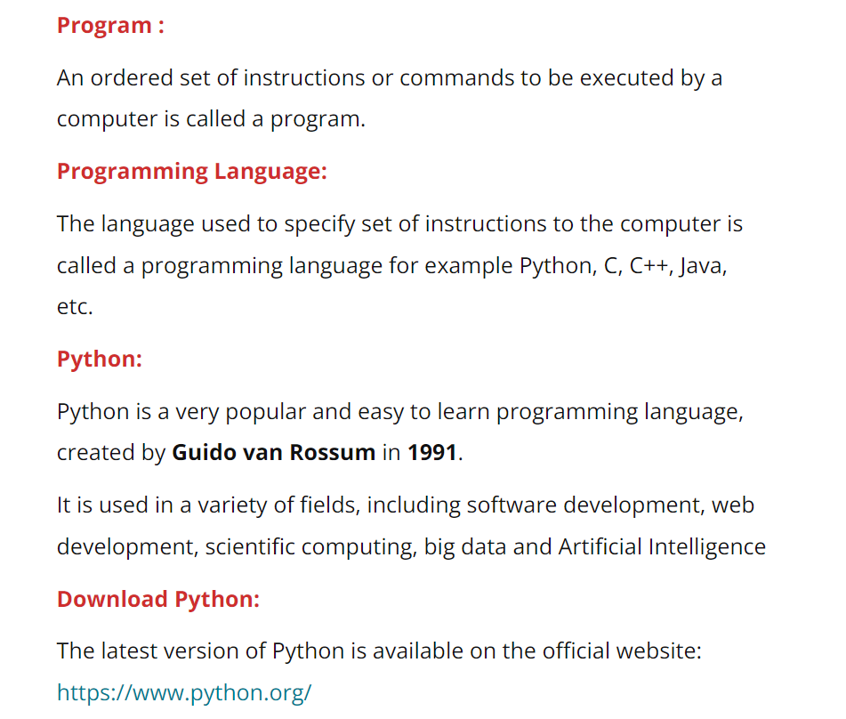
3.1 Introduction to Python

Slide 4
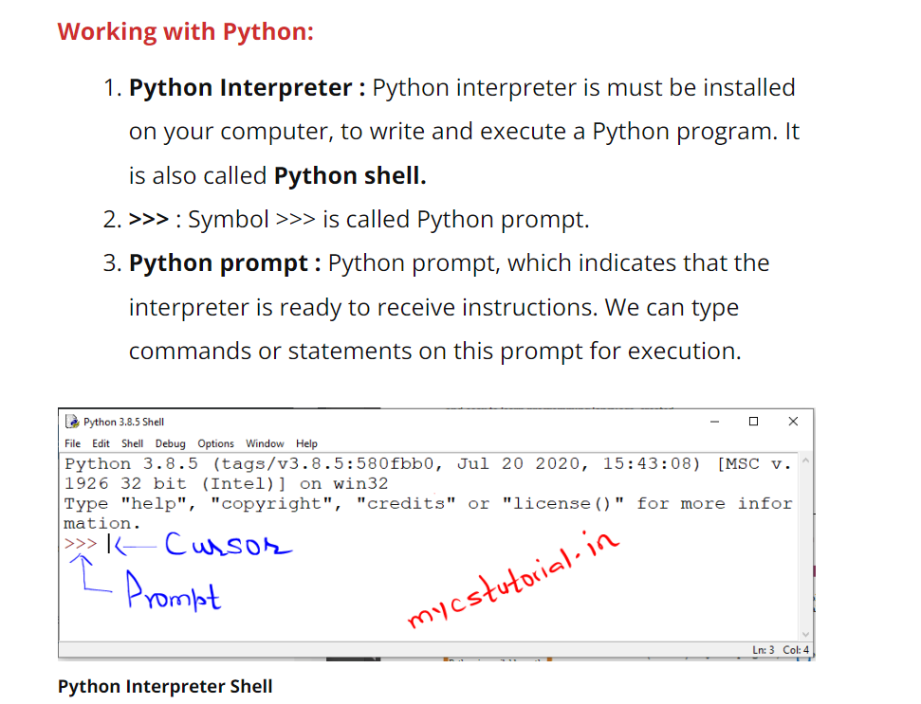

Slide 5
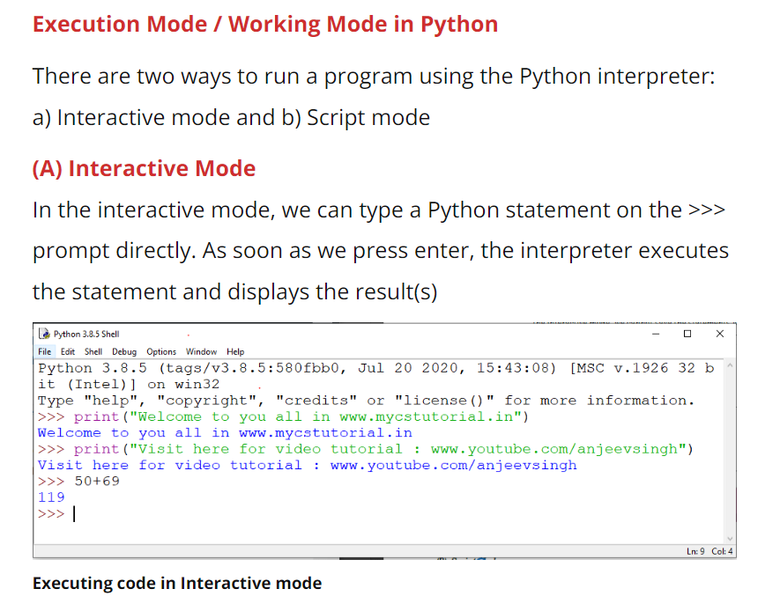

Slide 6
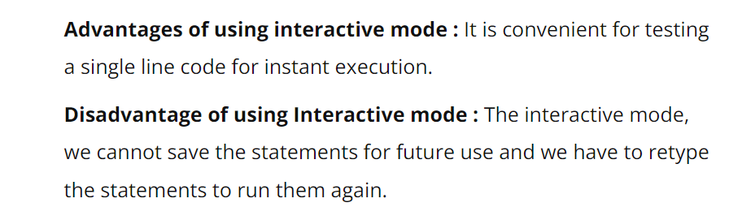

Slide 7
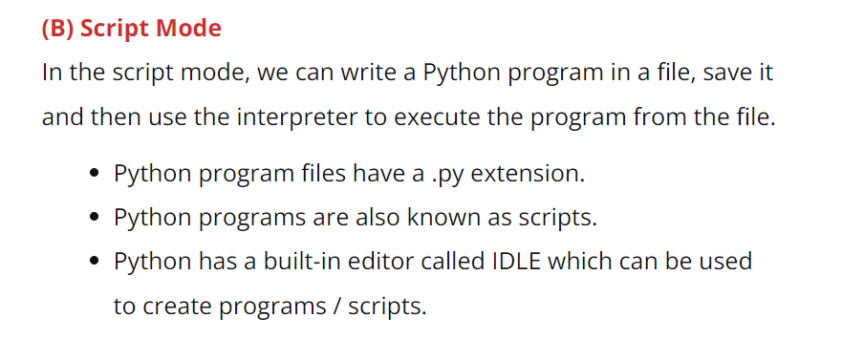

Slide 8
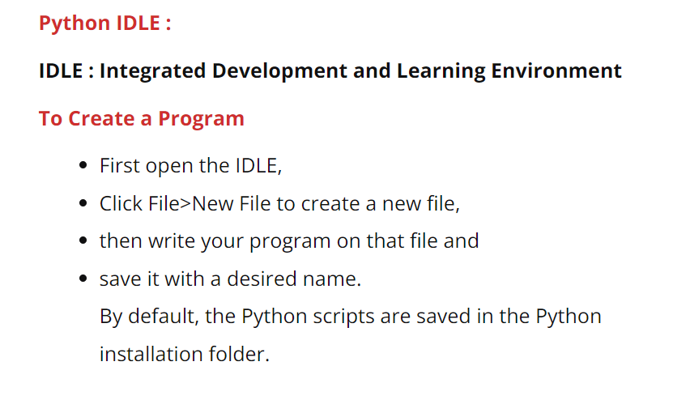

Slide 9
